Slide 1
Statistics in Sports: Basketball Overview
Zachary Binney, PhD MPH
Oxford college of emory university
Fall 2023

Slide 2
Roadmap
1. Sports Analytics “Culture Wars”
2. Rate Stats
3. Expected (Shot) Values
High-Value and Low-Value Shots (a/k/a Death of the Midrange Jumper)
4. The Quest for Holistic Statistics
Four Factors
PER
Plus-Minus
5. The Future: Expected Points Value Added (EPVA)
6. Hot Hand Fallacy (?) and Selection Effects

Slide 3
Sports Analytics “Culture Wars”

Slide 4
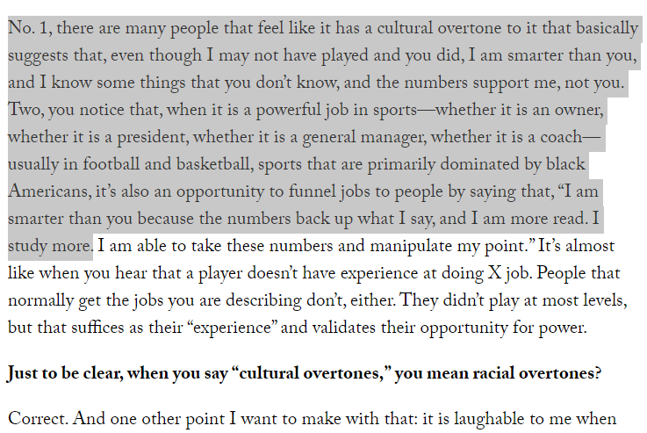
Analytics Culture War
“Outsiders” not just in a nerd vs. jock sense
In NBA and NFL (in U.S.) especially, also a racial/diversity component
Think about how you come across in the environment you’re entering
Watchword: humble
Jalen Rose, Bomani Jones, Shane Battier, and basketball analytics “resistance”:
Jalen Rose, on NBA Analytics:
Source: SEE links

Slide 5
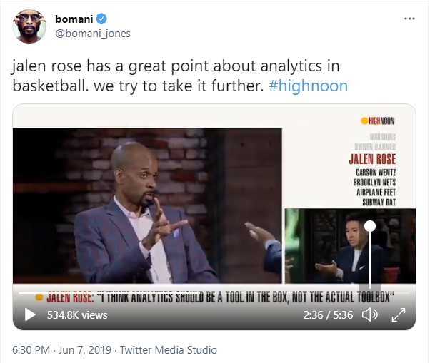
Analytics Culture War
Source: https://twitter.com/bomani_jones/status/1137124576100569095?lang=en
Notes:
For video, watch from ~2:00-4:10

Slide 6
Rate Stats

Slide 7
Which Player Was Better?
Stats from a 5-game playoff series:
Player A:
Player B
Source: basketball-reference.com

Slide 8
Which Player Was Better?
Stats from a 5-game playoff series:
Player A:
Player B
Source: basketball-reference.com

Slide 9
Which Player Was Better?
Stats from a 5-game playoff series:
Player A:
Player B
Who are Player A and Player B?
Bonus points: what series?
Source: basketball-reference.com

Slide 10
Which Player Was Better?
Stats from 2012-13 MIA-NYK 1st round matchup:
Player A:
Player B
Source: basketball-reference.com

Slide 11
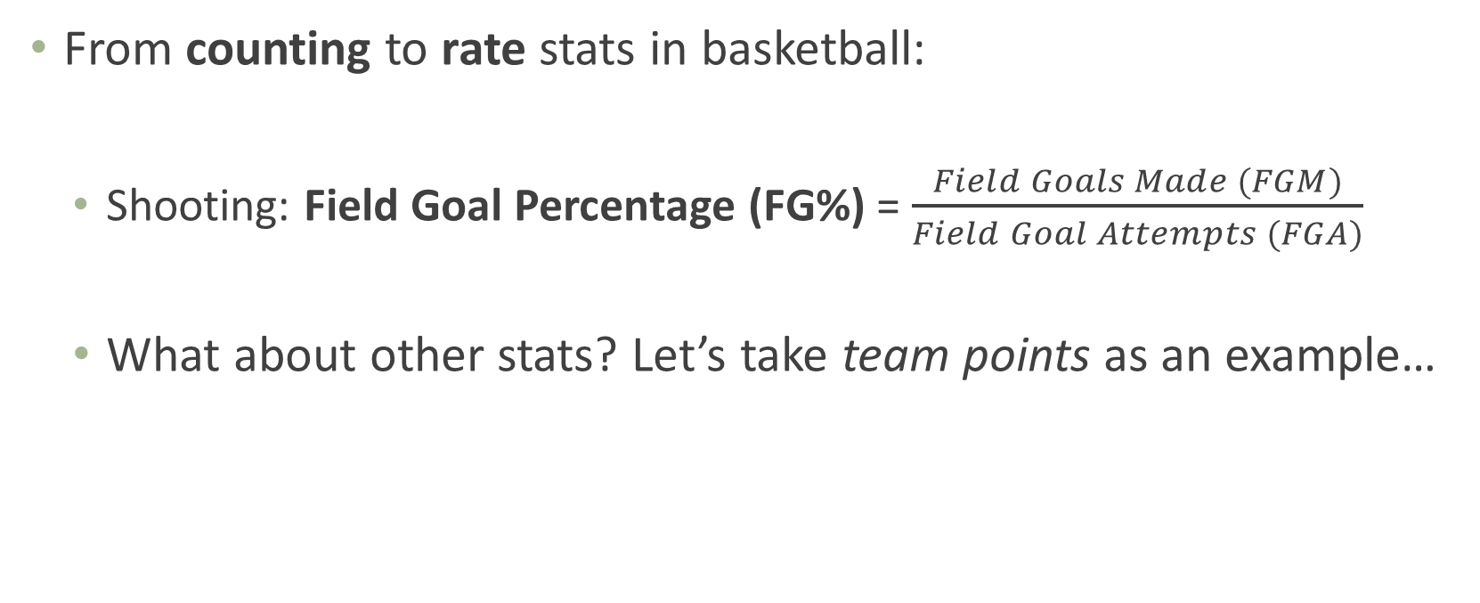
Denominators in Basketball
From counting to rate stats in basketball:
Shooting: Field Goal Percentage (FG%) = $\frac{Field Goals Made (FGM)}{Field Goal Attempts (FGA)}$
What about other stats? Let’s take team points as an example…

Slide 12
Denominators in Basketball
Points per…
Game?
Minute (or “Per 36” or “Per 48”)?

Slide 13
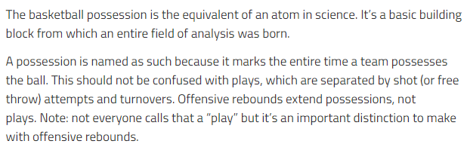
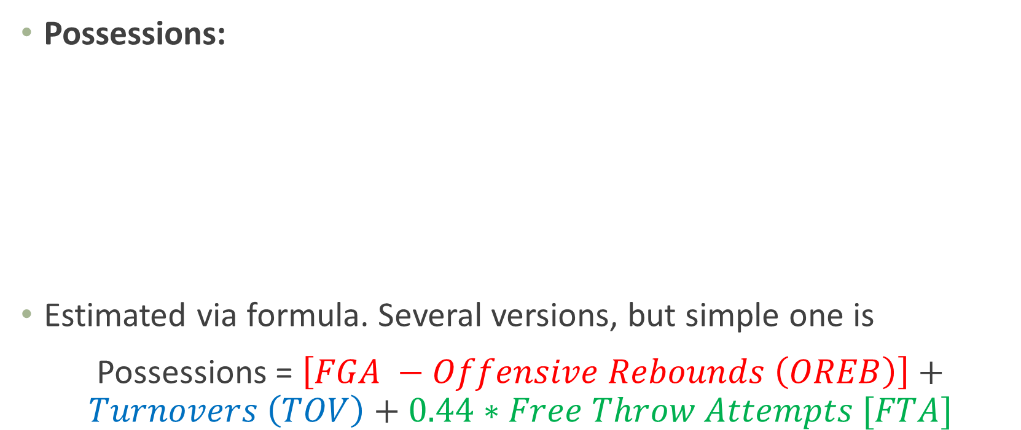
Denominators in Basketball: Possessions
Possessions:
Estimated via formula. Several versions, but simple one is
Possessions = $\left[FGA −Offensive Rebounds \left(OREB\right)\right]+Turnovers \left(TOV\right)+0.44∗Free Throw Attempts [FTA]$
Source: https://fansided.com/2015/12/21/nylon-calculus-101-possessions/

Slide 14
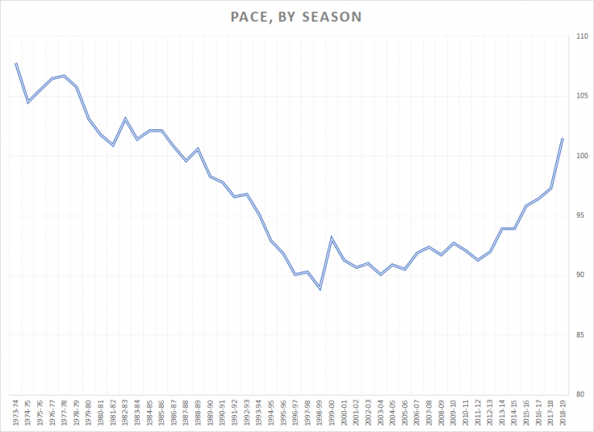
Denominators in Basketball: Possessions
Why possessions?
1. Is it easier to score 95 points in a 100-possession game or a 120-possession game?
2.
Many basketball stats are standardized to per 100 possessions
Source: https://www.lineups.com/articles/why-nba-game-pace-is-at-historic-high/

Slide 15
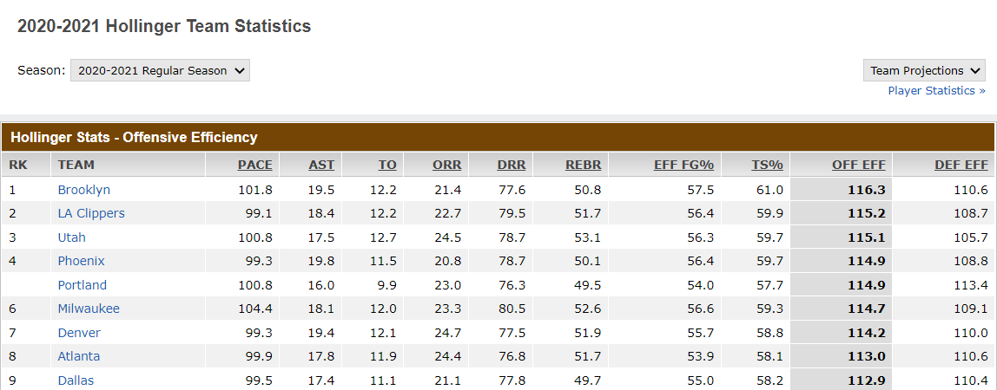
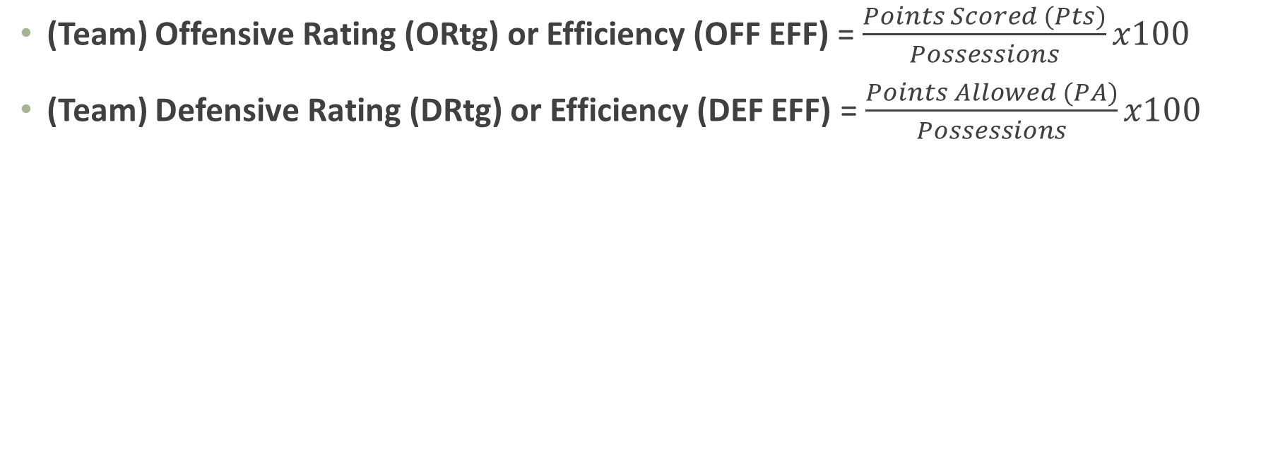
(Team) Offensive and Defensive Rating
(Team) Offensive Rating (ORtg) or Efficiency (OFF EFF) = $\frac{Points Scored (Pts)}{Possessions}x100$
(Team) Defensive Rating (DRtg) or Efficiency (DEF EFF) = $\frac{Points Allowed (PA)}{Possessions}x100$
Source: http://www.espn.com/nba/hollinger/teamstats

Slide 16
Expected (Shot) Values

Slide 17
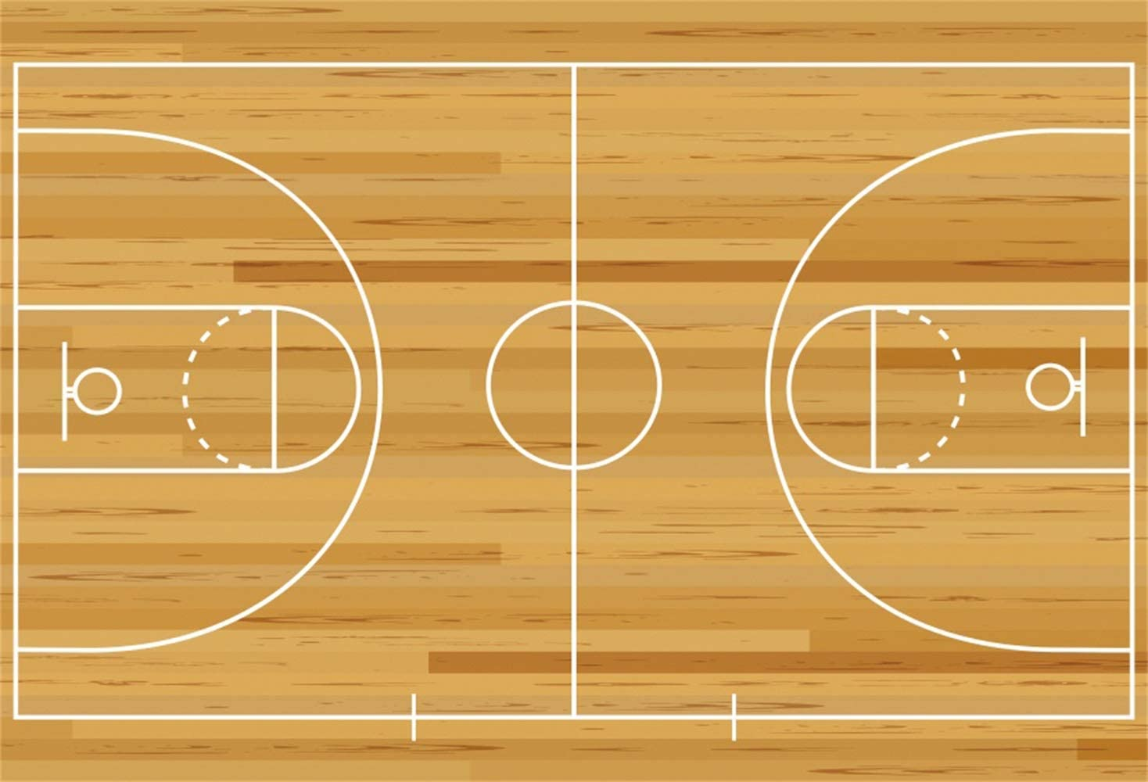
How Much is a Shot Worth?
Not all shots are created equal (or worth the same points)
3 pts
2 pts
1 pt
Source: https://www.amazon.com/Leowefowa-Basketball-Backdrop-Background-Birthday/dp/B07YF3THL7

Slide 18
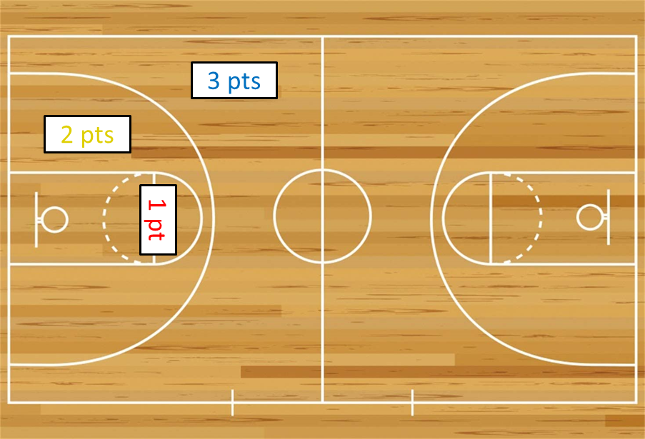
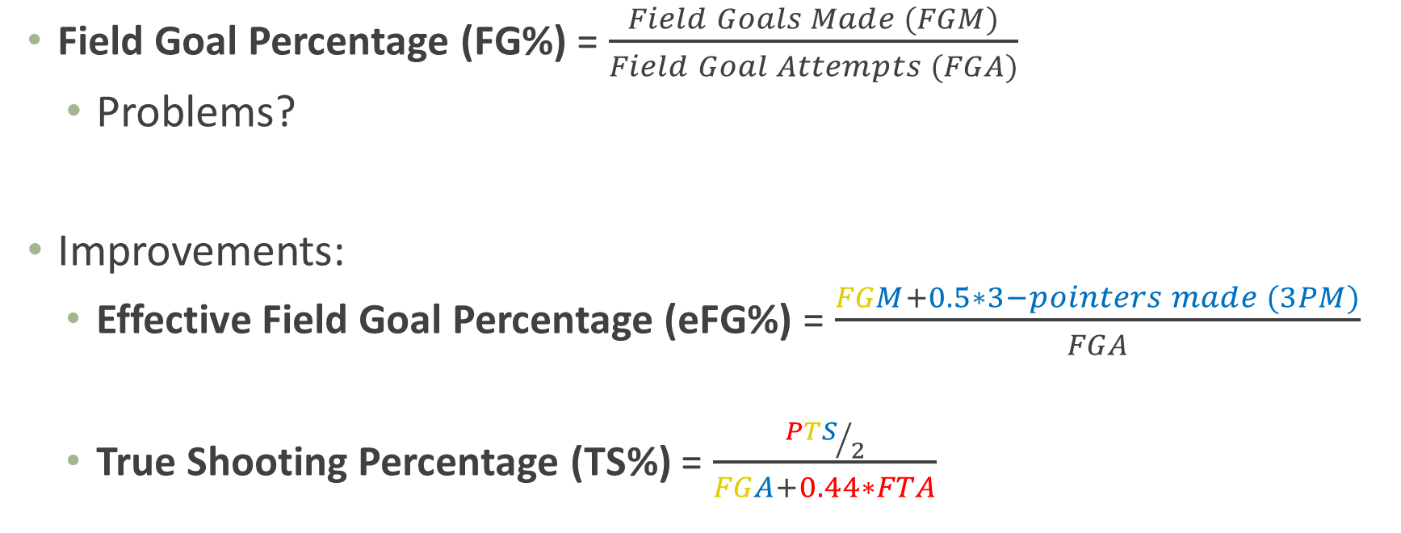
Effective Field Goal Percentage + True Shooting Percentage
Field Goal Percentage (FG%) = $\frac{Field Goals Made (FGM)}{Field Goal Attempts (FGA)}$
Problems?
Improvements:
Effective Field Goal Percentage (eFG%) = $\frac{FGM+0.5∗3−pointers made (3PM)}{FGA}$
True Shooting Percentage (TS%) = $\frac{{PTS}/2}{FGA+0.44∗FTA}$

Slide 19
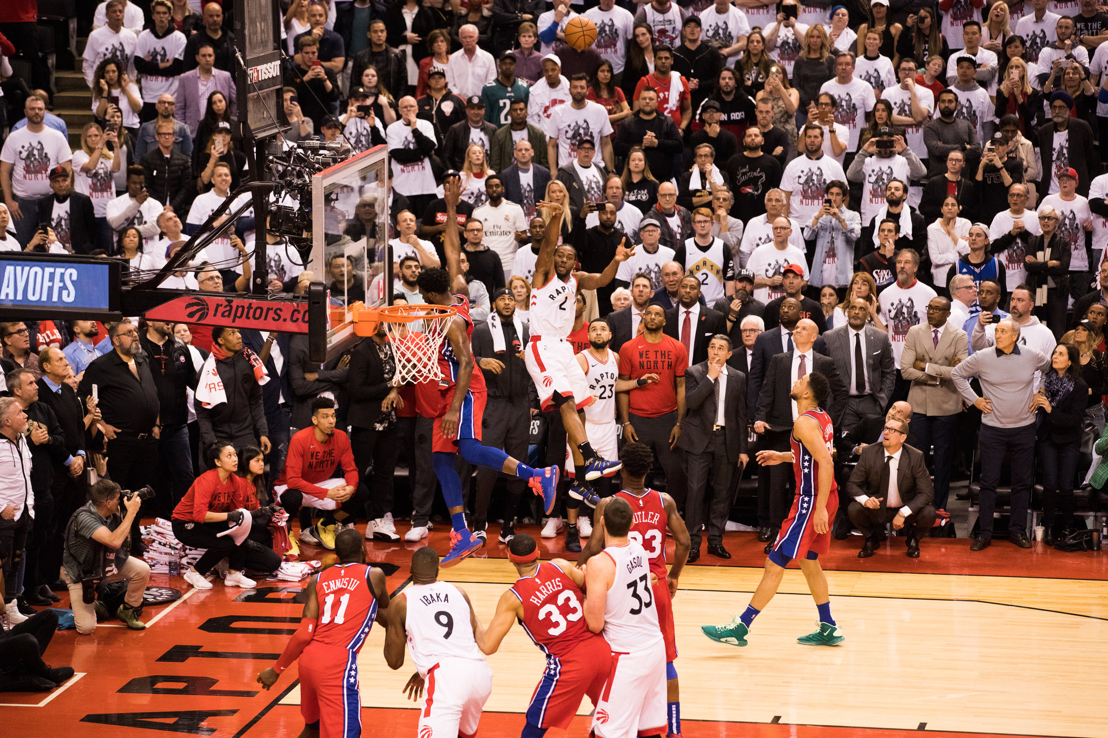
How Much is a Shot Worth…Really?
At the time of this photo, how much is this shot worth? What is its “value?”
Source: https://www.nytimes.com/2019/05/12/sports/nba-playoffs-trail-blazers-nuggets-sixers-raptors.html

Slide 20
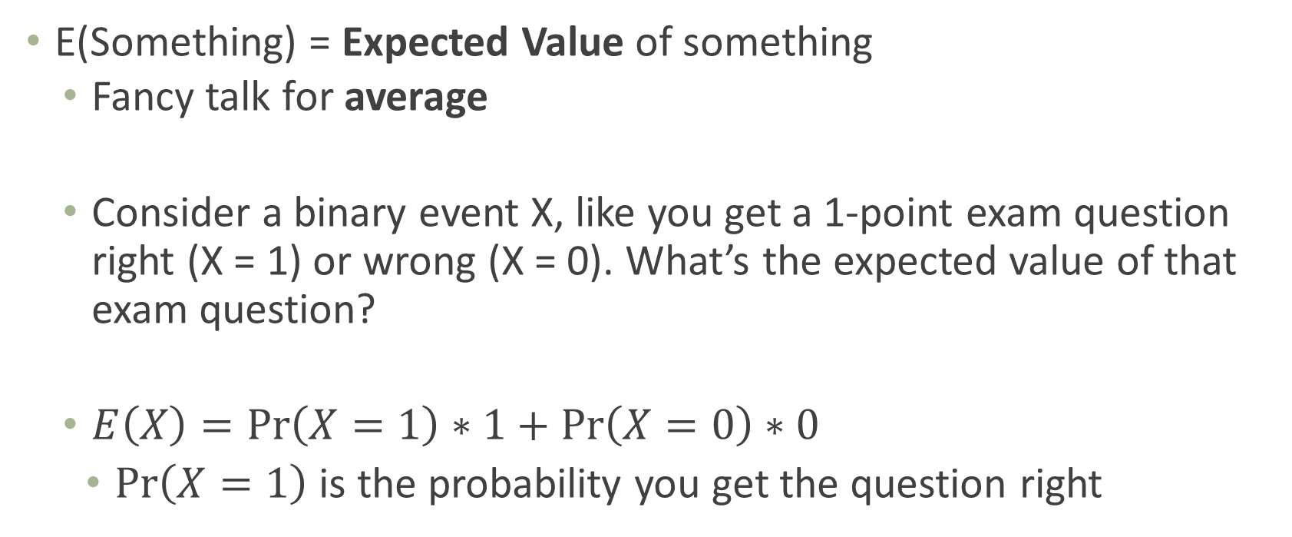
Expected Value
E(Something) = Expected Value of something
Fancy talk for average
Consider a binary event X, like you get a 1-point exam question right (X = 1) or wrong (X = 0). What’s the expected value of that exam question?
$E\left(X\right)=\operatorname{Pr}\left(X=1\right)∗1+\operatorname{Pr}\left(X=0\right)∗0$
$\operatorname{Pr}\left(X=1\right)$ is the probability you get the question right

Slide 21
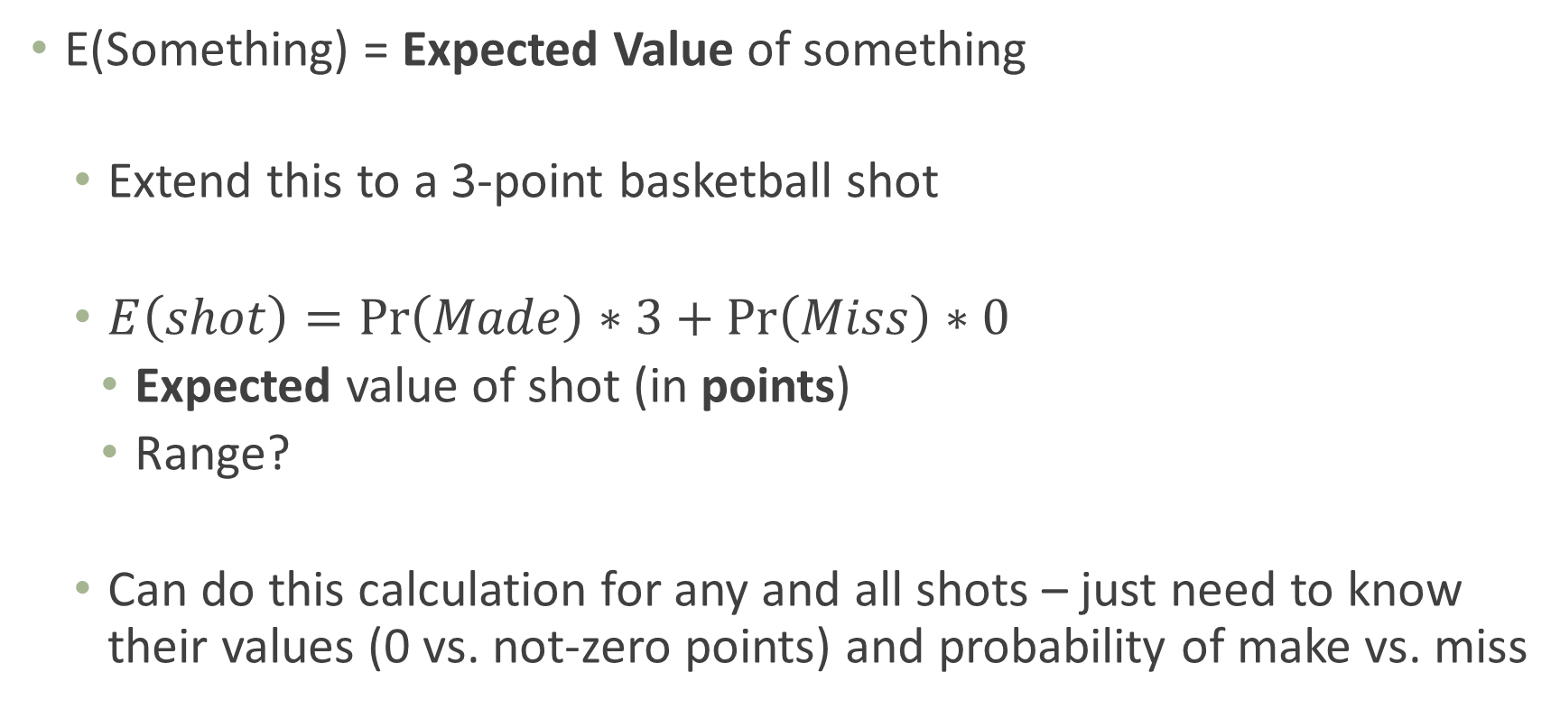
Expected Value
E(Something) = Expected Value of something
Extend this to a 3-point basketball shot
$E\left(shot\right)=\operatorname{Pr}\left(Made\right)∗3+\operatorname{Pr}\left(Miss\right)∗0$
Expected value of shot (in points)
Range?
Can do this calculation for any and all shots – just need to know their values (0 vs. not-zero points) and probability of make vs. miss
Source: https://www.nytimes.com/2019/05/12/sports/nba-playoffs-trail-blazers-nuggets-sixers-raptors.html

Slide 22
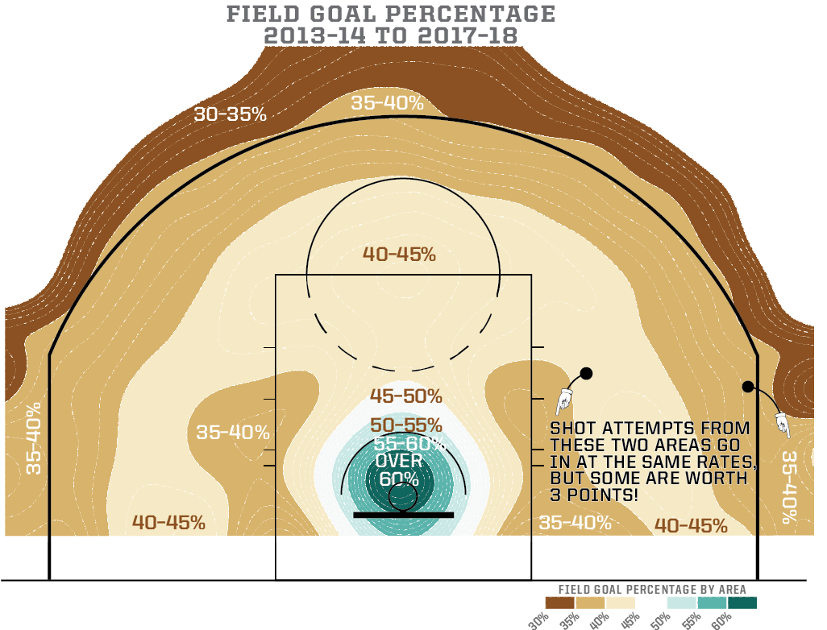
NBA Shot Value
Source: https://fivethirtyeight.com/features/how-mapping-shots-in-the-nba-changed-it-forever/

Slide 23
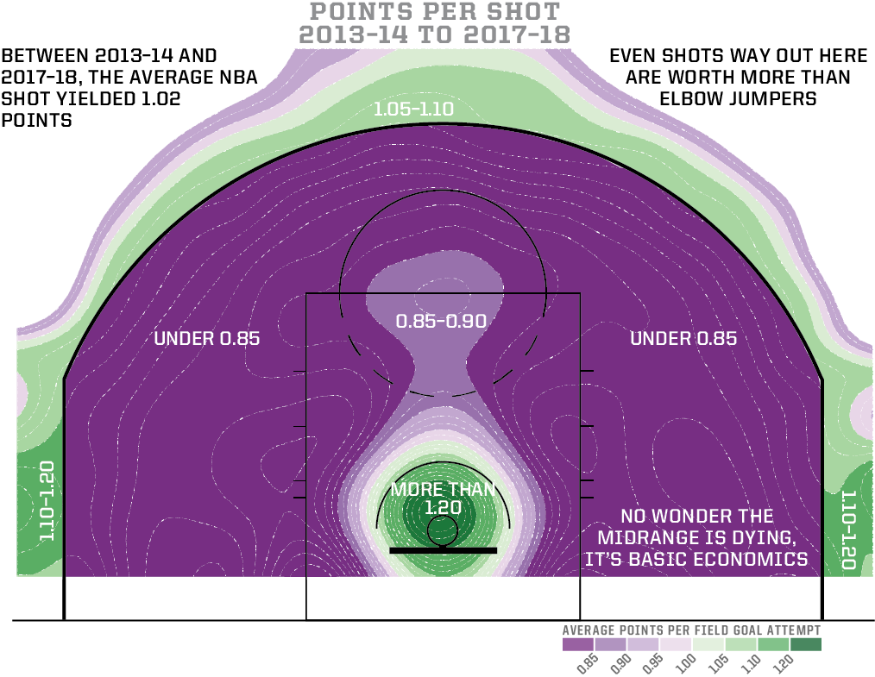
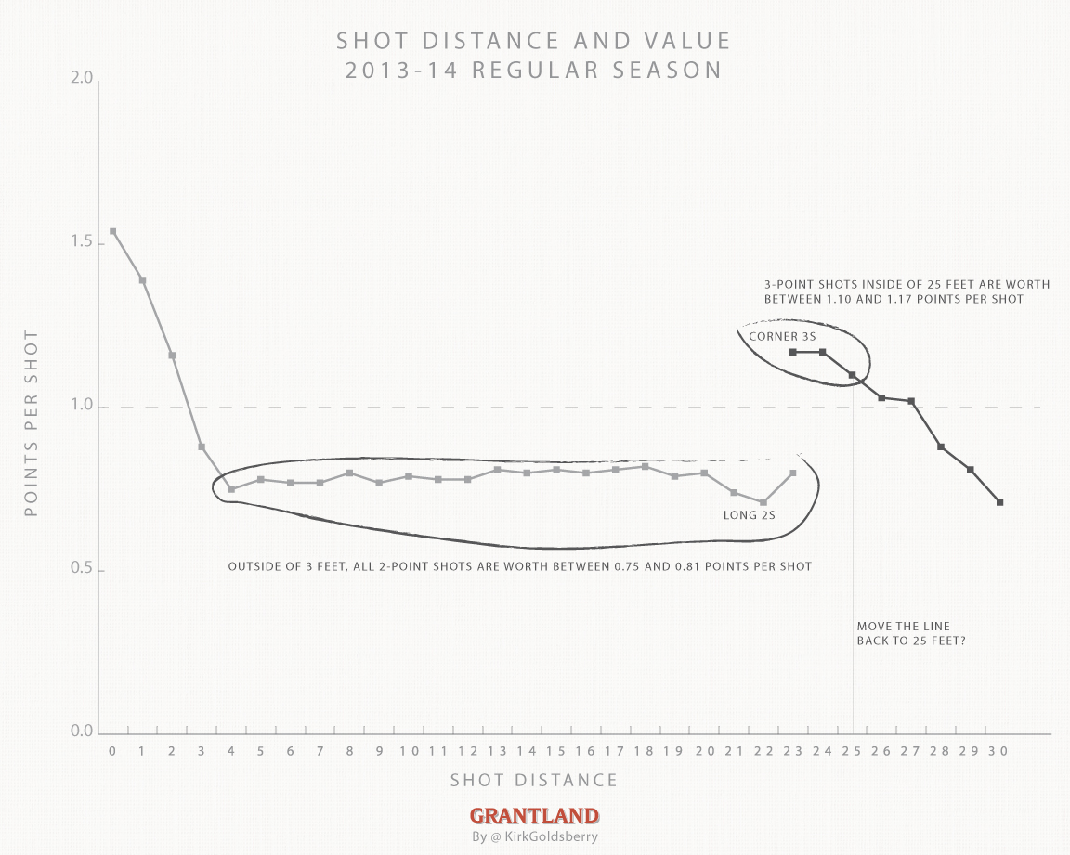
NBA Shot Value
Source: https://grantland.com/the-triangle/is-it-time-to-move-the-nba-3-point-line-back/

Slide 24
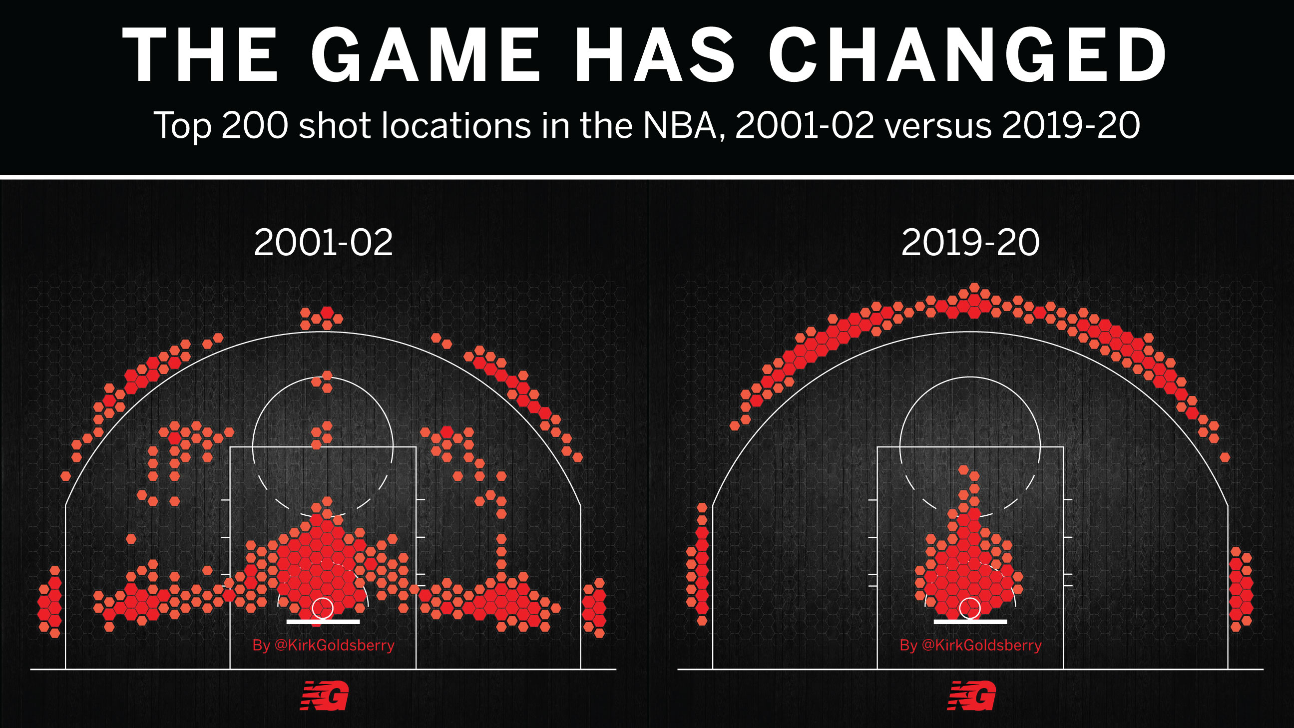
“Death of the Midrange Jumper”/ “Moreyball”
Source: https://twitter.com/kirkgoldsberry/status/1217109175894831105?s=20

Slide 25
The Quest for Holistic Statistics
Four factors
PER
Plus-minus statistics

Slide 26
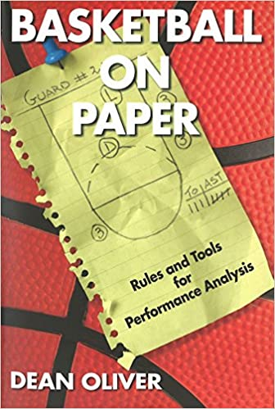
Four Factors
Shooting isn’t all there is to winning basketball games
Dean Oliver’s Four Factors from Basketball on Paper:
1. Shooting/Scoring Efficiently (40%)
Measured with eFG%

Slide 27
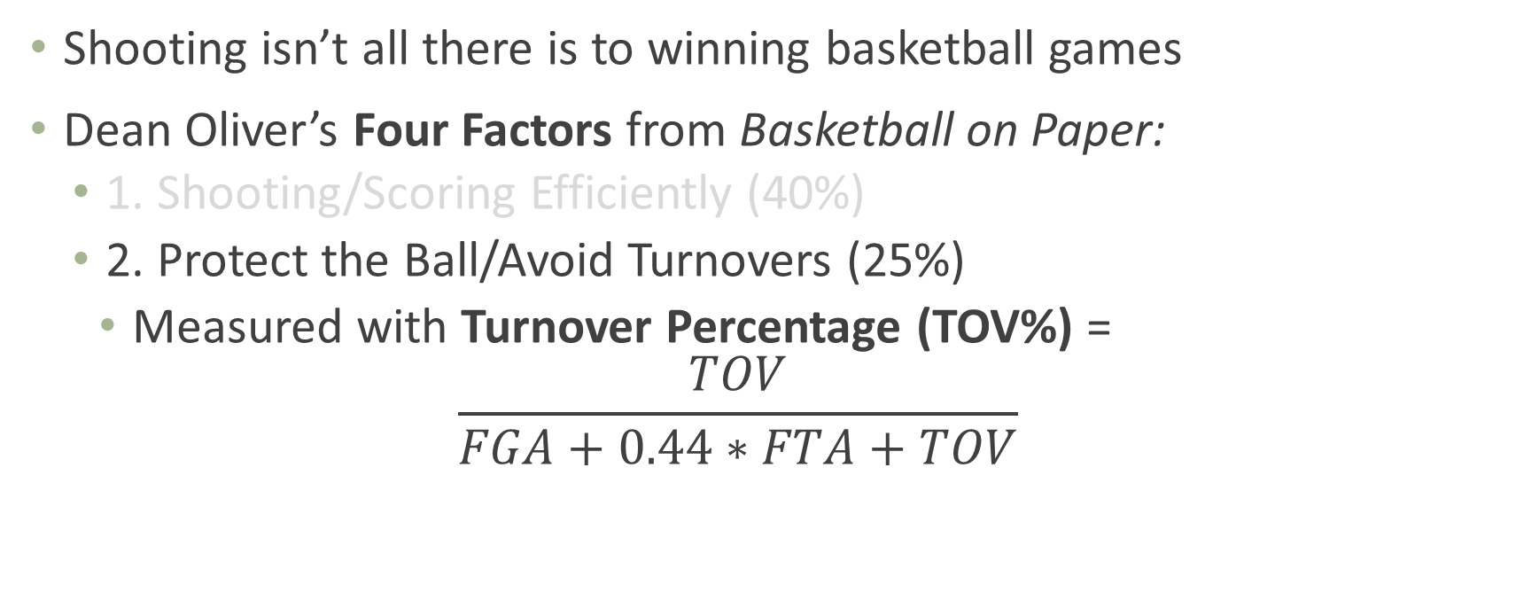
Four Factors
Shooting isn’t all there is to winning basketball games
Dean Oliver’s Four Factors from Basketball on Paper:
1. Shooting/Scoring Efficiently (40%)
2. Protect the Ball/Avoid Turnovers (25%)
Measured with Turnover Percentage (TOV%) = $\frac{TOV}{FGA+0.44∗FTA+TOV}$

Slide 28
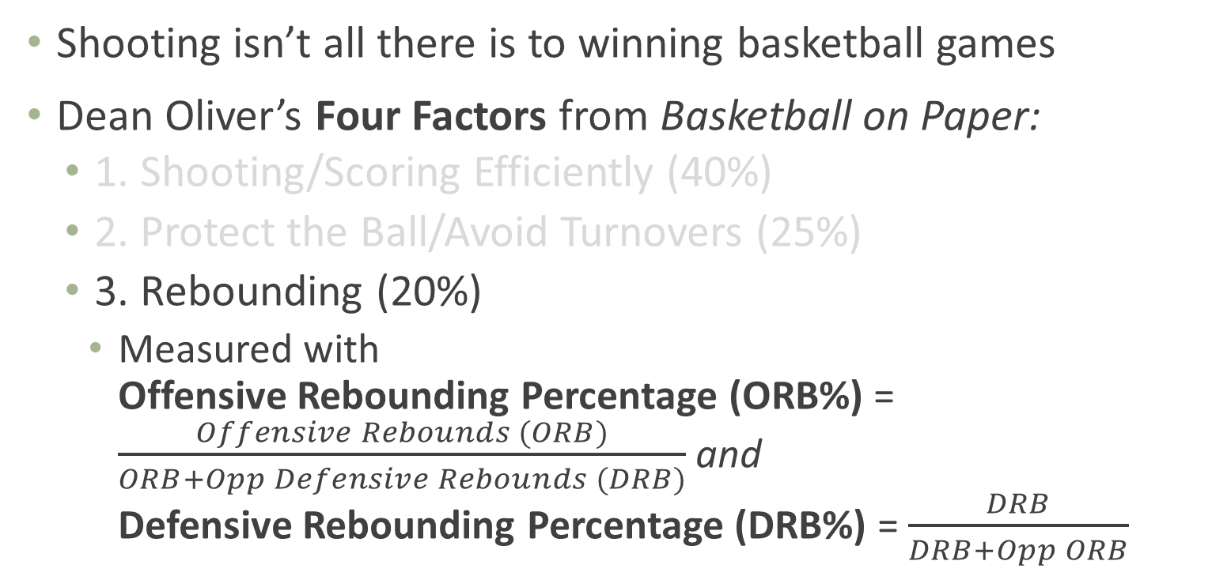
Four Factors
Shooting isn’t all there is to winning basketball games
Dean Oliver’s Four Factors from Basketball on Paper:
1. Shooting/Scoring Efficiently (40%)
2. Protect the Ball/Avoid Turnovers (25%)
3. Rebounding (20%)
Measured with Offensive Rebounding Percentage (ORB%) = $\frac{Offensive Rebounds (ORB)}{ORB+Opp Defensive Rebounds (DRB)}$ and Defensive Rebounding Percentage (DRB%) = $\frac{DRB}{DRB+Opp ORB}$

Slide 29
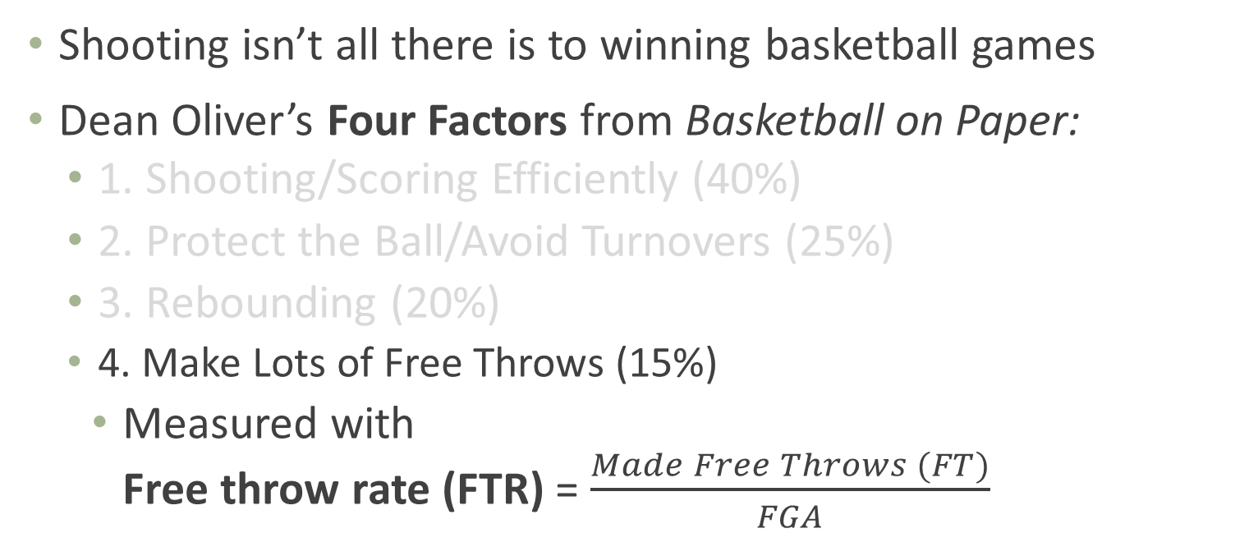
Four Factors
Shooting isn’t all there is to winning basketball games
Dean Oliver’s Four Factors from Basketball on Paper:
1. Shooting/Scoring Efficiently (40%)
2. Protect the Ball/Avoid Turnovers (25%)
3. Rebounding (20%)
4. Make Lots of Free Throws (15%)
Measured with Free throw rate (FTR) = $\frac{Made Free Throws (FT)}{FGA}$

Slide 30
Four Factors
Dean Oliver’s Four Factors from Basketball on Paper:
1. Shooting/Scoring Efficiently (40%)
2. Protect the Ball/Avoid Turnovers (25%)
3. Rebounding (20%)
4. Make Lots of Free Throws (15%)
Really Eight Factors – offense + defense. But doesn’t roll off the tongue, does it?
Weights are debated; Oliver’s from a program called “Roboscout” that sounds like a regression model of some kind?

Slide 31
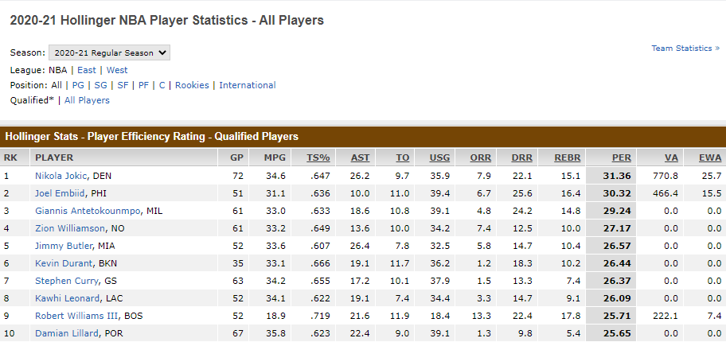
Player Efficiency Rating (PER)
Player Efficiency Rating (PER), from John Hollinger: "The PER sums up all a player's positive accomplishments, subtracts the negative accomplishments, and returns a per-minute rating of a player's performance.“
Formula = complicated, but incorporates 2- and 3-point shots, free throws, assists, steals, blocks, turnovers, fouls, offensive + defensive rebounds
Underrates defense?
Source: http://insider.espn.com/nba/hollinger/statistics

Slide 32
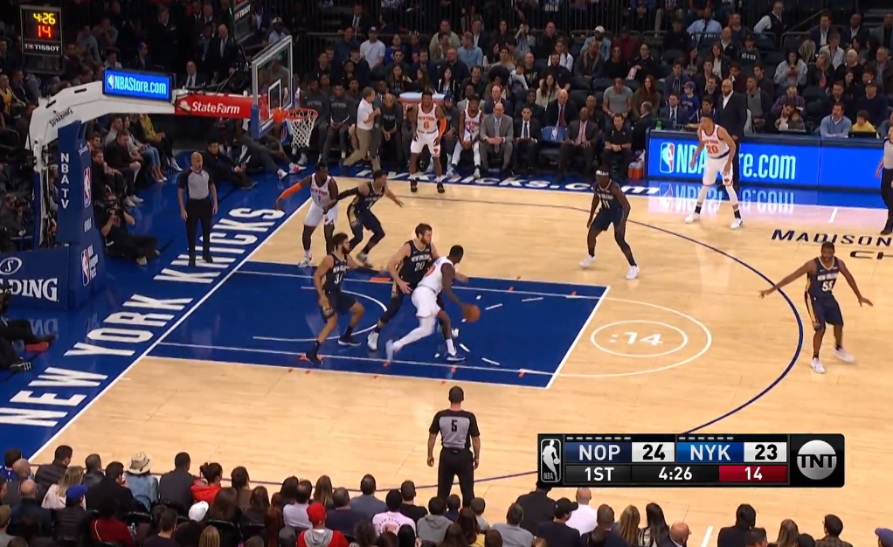
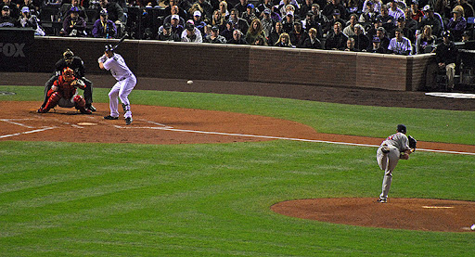
Basketball is Complex
What’s the point of basketball? How do you win?
So how might you go about measuring the value of a player and all they do (esp. defense)?
Source: https://awfulannouncing.com/turner/tnt-tries-out-an-on-court-shot-clock-graphic-to-mixed-reviews.html; https://tht.fangraphs.com/can-we-predict-hitters-change-based-on-how-pitchers-approach-them/

Slide 33
Basketball is Complex
How do you go about looking at the value of anything, like…oh, I dunno, let’s say just for no particular reason…a vaccine?
Source: https://awfulannouncing.com/turner/tnt-tries-out-an-on-court-shot-clock-graphic-to-mixed-reviews.html; https://tht.fangraphs.com/can-we-predict-hitters-change-based-on-how-pitchers-approach-them/

Slide 34
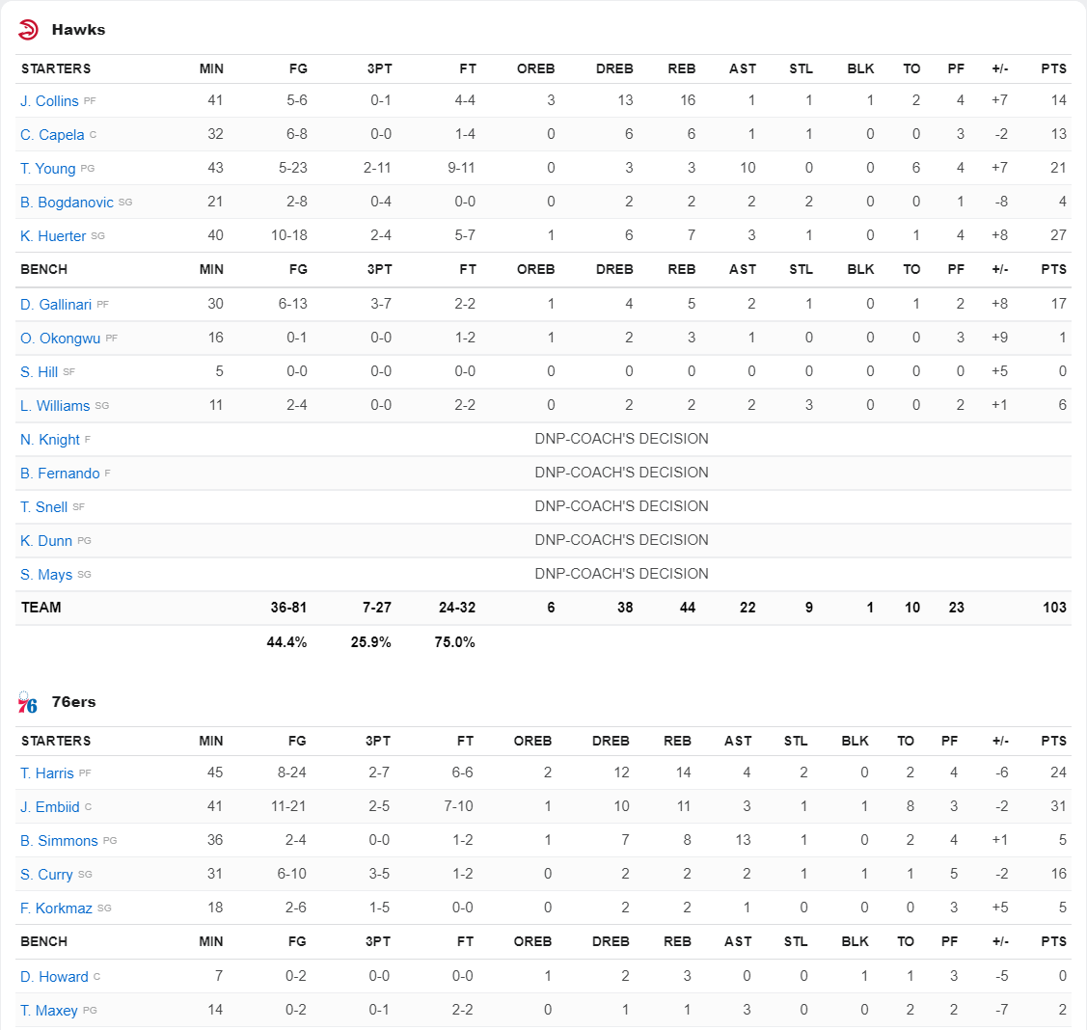
Plus-Minus
(Traditional) Plus-Minus (+/-): score differential when player is in the game
Problems?
Source: https://www.espn.com/nba/boxscore?gameId=401332958

Slide 35
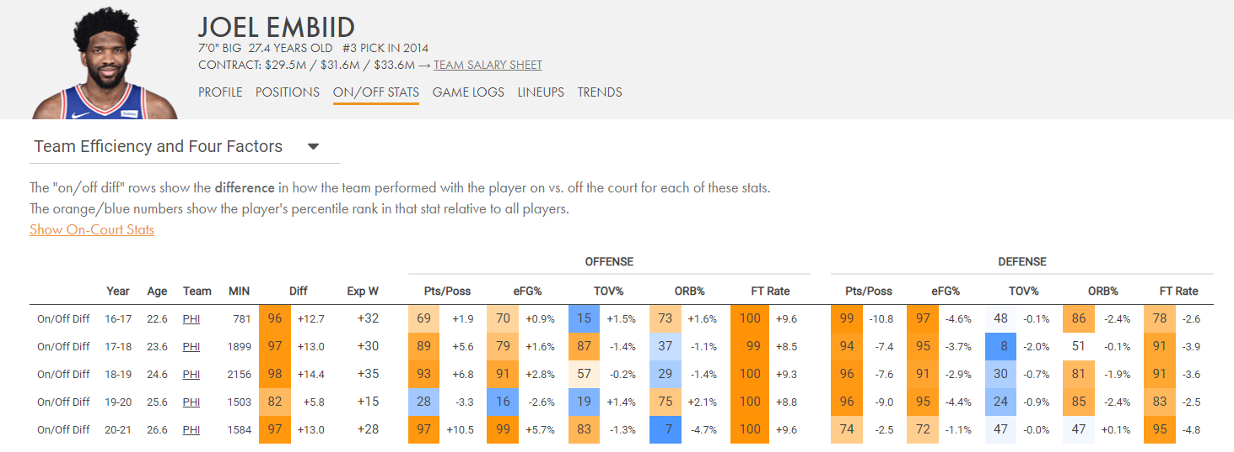
On-Off Court Splits
On-Off splits: addresses problem of how team does with compared to without this player
Problems?
Source: https://cleaningtheglass.com/stats/player/1049/onoff#tab-team_efficiency

Slide 36
Defining Player Value – Question Type
1. Descriptive
Describing the world as it is
2. Predictive
Describing the world as it will be
3. Causal (Counterfactual Prediction)
Describing the world as it could be
Plus-minus, on/off is a correlation. Distinguishing that from causation adds a whole other layer of difficulty!

Slide 37
Adjusted Plus-Minus
Adjusted Plus-Minus (APM): adjusts +/- for presence of other players, opponents, and various other factors (like home vs. away, coaches, etc.) depending on particular model
Adds context; deals with how team does when player is on with certain players, on with other players, or off
Uses multivariable regression models
Huh? Bear with me…

Slide 38
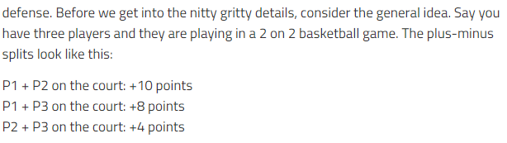
Adjusted Plus-Minus
APM calculations, the basics:
Stint = period of the game with no subs
Source: https://fansided.com/2014/09/25/glossary-plus-minus-adjusted-plus-minus/

Slide 39
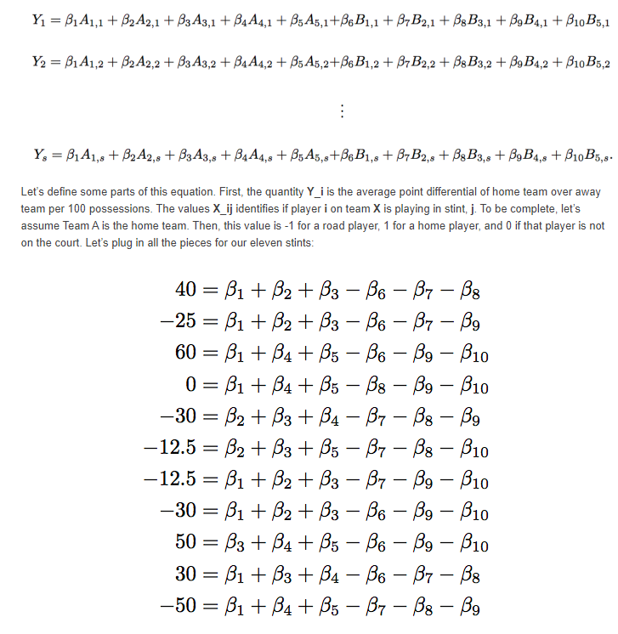
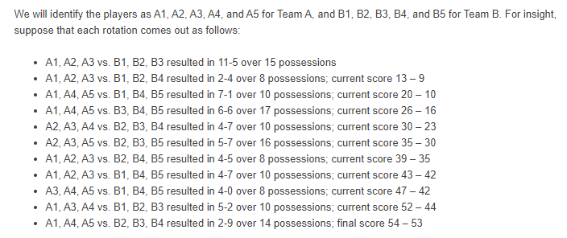
Adjusted Plus-Minus
APM calculations – the basics
3x3 game, 2 teams of 5 players:
+/- per 100 possessions = +6*100/15 = 40
Source: https://squared2020.com/2017/09/18/deep-dive-on-regularized-adjusted-plus-minus-i-introductory-example/

Slide 40
Adjusted Plus-Minus
Adjusted Plus-Minus (APM): adjusts +/- for presence of other players, opponents, and various other factors (like home vs. away, coaches, etc.) depending on particular model
Remaining problems?
1. Collinearity – some players play together a lot, others barely (or not at all). Use “Regularization” to deal with that → Regularized Adjusted Plus-Minus (RAPM)
Better predictive ability for future years
2. APM varies wildly year-to-year (not “repeatable”), depends on new players, coaching and role changes, etc.
3. Why is a player good?
Implications for team-building?
4. Nick Collison Effect – fixes?
Source: https://fansided.com/2014/09/25/glossary-plus-minus-adjusted-plus-minus/

Slide 41
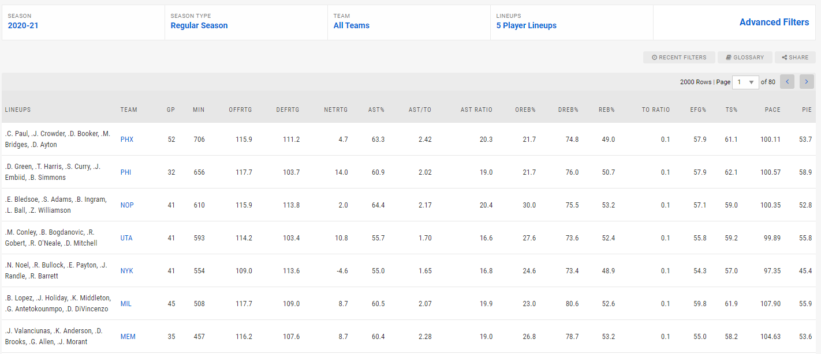
Lineup Stats
Due to limitations of individual +/-, just look at holistic lineup stats?
Source: https://fansided.com/2014/09/25/glossary-plus-minus-adjusted-plus-minus/

Slide 42
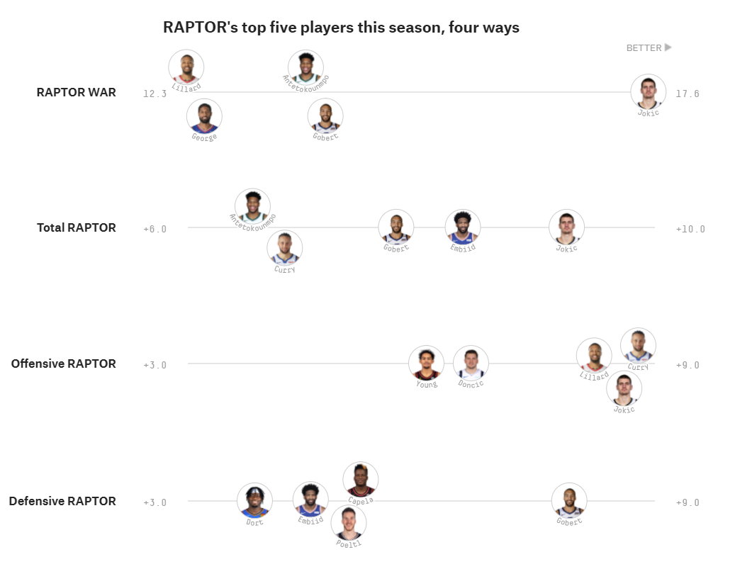
Variations on a Theme
+/-
APM
RAPM
Real Plus-Minus (RPM, ESPN’s main stat) – adds in some other adjustments to RAPM like aging curves and game condition
FiveThirtyEight’s CARMELO (old) and RAPTOR (more recent, but no longer updated) NBA projection and player valuation systems
LEBRON from Basketball Index, Estimated Plus-Minus, Daily Plus-Minus (DPM from DARKO)
And so many more…
Source: https://fivethirtyeight.com/features/introducing-raptor-our-new-metric-for-the-modern-nba/

Slide 43
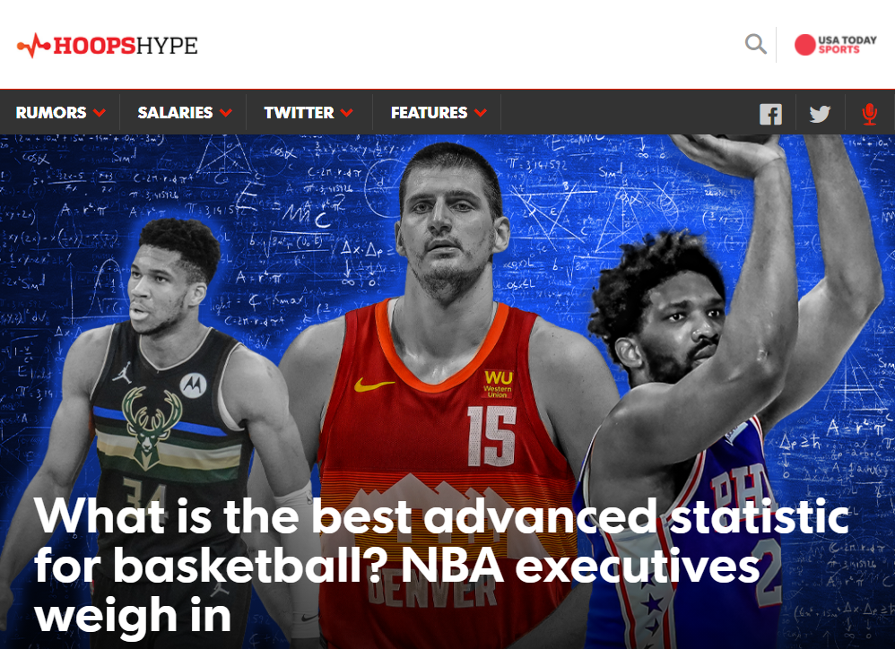
Overview of Holistic Metrics
Great survey and overview of +/- style metrics and how NBA executives think about them
Source: https://hoopshype.com/lists/advanced-stats-nba-real-plus-minus-rapm-win-shares-analytics/

Slide 44
The Future: Expected Points Value Added (EPVA)

Slide 45
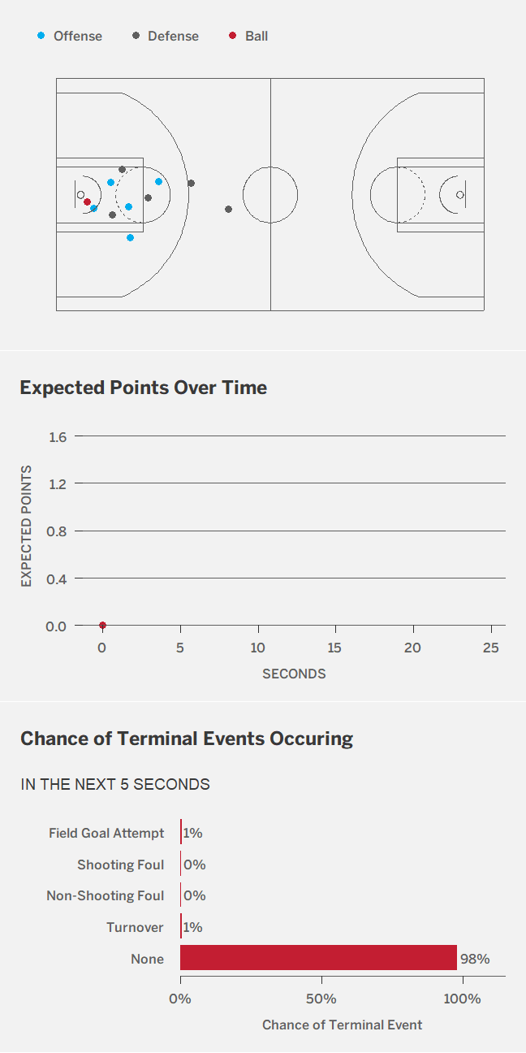
Tracking Data: Expected Points Value Added (EPVA)
Use tracking data to estimate real-time value of a possession
Isolate effects of individual events, then sum up all a player’s actions (vs. average player)
Source: https://hdsr.mitpress.mit.edu/pub/kxks56er/release/4
Notes:
For video, watch from ~2:00-4:10

Slide 46
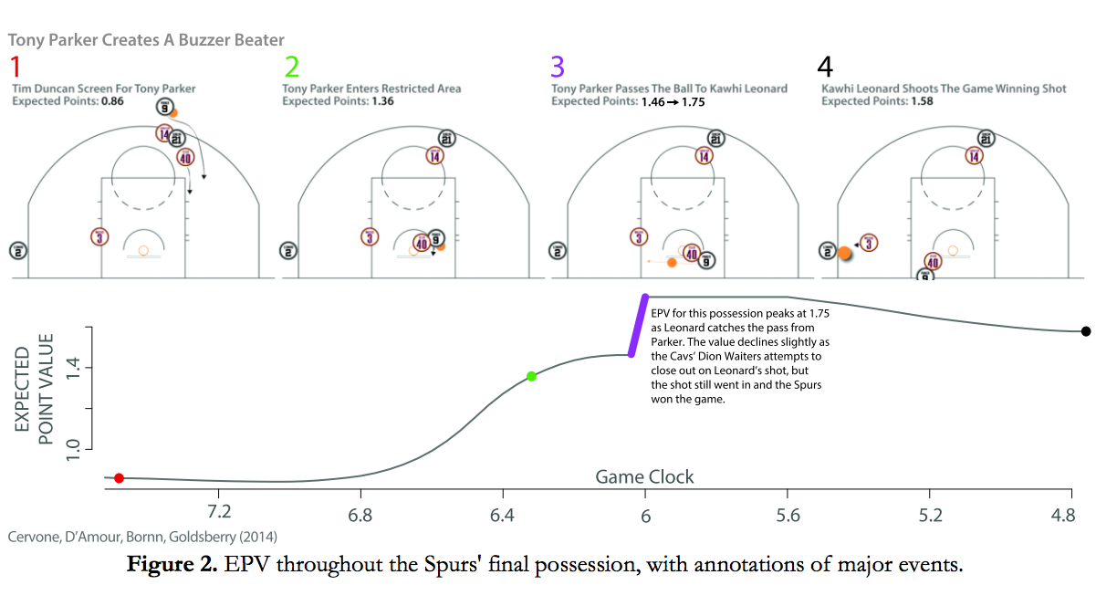
Tracking Data: Expected Points Value Added (EPVA)
Spurs-Cavs, February 13, 2013
Source: https://deadspin.com/kirk-goldsberrys-new-nba-stat-is-a-huge-step-for-baske-1517481614
Notes:
For video, watch from ~2:00-4:10

Slide 47
Hot Hand Fallacy (?) and Selection Effects

Slide 48
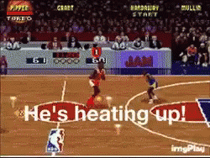
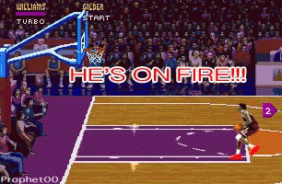
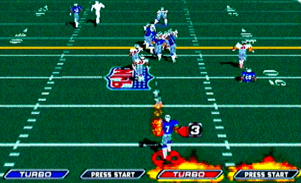
The Hot Hand
Source: NBA Jam, NFL Blitz
Notes:
For video, watch from ~2:00-4:10

Slide 49
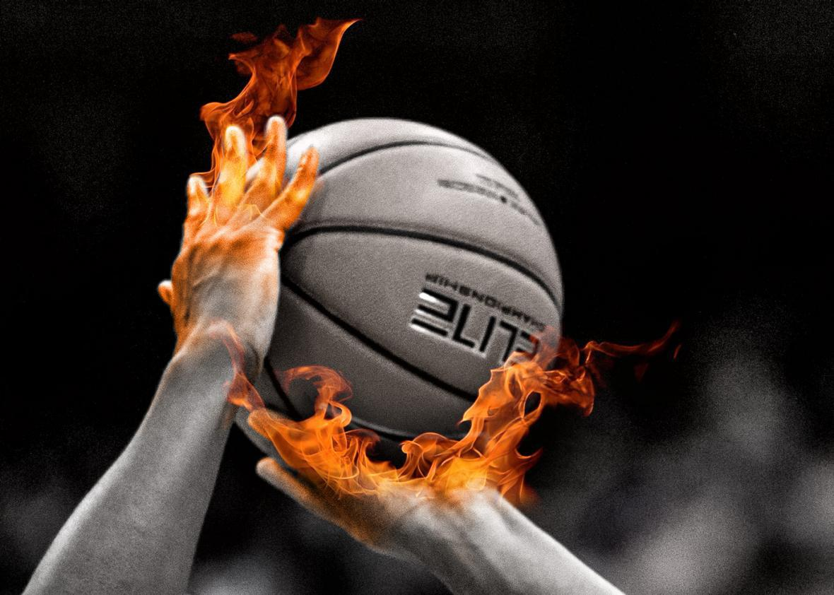
The Hot Hand
People are streaky
Success breeds success
Example: basketball players more likely to make shots after previous makes; “get in a rhythm”
Many other sports and skill-based activities
Coaches, players, experts strongly believe it exists
Source: https://slate.com/technology/2015/10/hot-hands-in-basketball-are-real-new-analysis-shows.html
Notes:
For video, watch from ~2:00-4:10

Slide 50
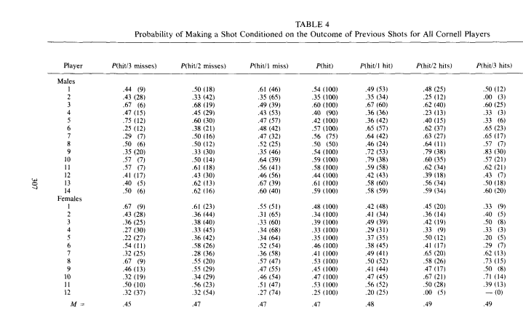
The Hot Hand Fallacy
Gilovich, Vallone, Tversky (GVT, 1985): ask Cornell basketball players to make 100 shots from a range where they shoot 50%
Also looked at ‘76ers shooting, Celtics paired FTs → similar results
People see patterns in randomness + confirmation bias
Source: GVT, Cognitive Psychology, 17:3, 1985
Notes:
For video, watch from ~2:00-4:10

Slide 51

The Hot Hand (Fallacy?)
Miller and Sanjurjo (2015): found a bias lurking in these types of analyses that had gone unrecognized for 30 years
Ready for your head to explode?
Really?
Everyone reach under your seats and put on your ponchos just in case
Source: https://giphy.com/explore/head-explode
Notes:
For video, watch from ~2:00-4:10

Slide 52
The Hot Hand (Fallacy?)
Miller and Sanjurjo (2015): found a bias lurking in these types of analyses that had gone unrecognized for 30 years
Consider a fair coin flipped 100 times
“Fair” means P(H) = P(T) = 0.5
What is the probability any 1 flip is heads? P(H) = ?
What is the probability any 1 flip following at least 3 heads is heads? P(H|_HHH) = ?
Source: https://www.scientificamerican.com/article/momentum-isnt-magic-vindicating-the-hot-hand-with-the-mathematics-of-streaks/

Slide 53
The Hot Hand (Fallacy?)
Miller and Sanjurjo (2015): found a bias lurking in these types of analyses that had gone unrecognized for 30 years
Random sequence of 100 makes and misses, 50% chance of each (51 makes, 49 misses)
Of shots after 3+ makes, only 4/11 (36%) are makes
Repeat 1,000 times → ~46% Makes (which, you’ll note, is <50%)
Issue: every streak has to end with a miss. Sometimes it’s a Miss after 0 more Makes, sometimes after 1, 2, …
Every time there will be a Miss; BUT there’s not always a Make to balance!
Sometimes 2+ Makes, but not as often as 0 Makes!
Our search forces a Miss >50% of the time! (Or a Make <50% of the time.)
Make | Make | Miss | Make | Miss | Make | Miss | Make | Miss | Miss
Miss | Miss | Miss | Make | Make | Miss | Make | Miss | Make | Miss
Miss | Make | Miss | Miss | Make | Miss | Miss | Make | Make | Miss
Miss | Miss | Make | Miss | Make | Make | Miss | Miss | Miss | Miss
Miss | Make | Make | Make | Miss | Make | Make | Make | Miss | Miss
Miss | Make | Make | Miss | Make | Make | Make | Make | Miss | Miss
Miss | Make | Miss | Miss | Miss | Make | Make | Make | Miss | Miss
Make | Miss | Make | Miss | Make | Make | Make | Miss | Miss | Miss
Miss | Make | Make | Make | Miss | Miss | Miss | Make | Make | Make
Make | Make | Miss | Make | Make | Miss | Make | Make | Make | Make
Source: https://www.scientificamerican.com/article/momentum-isnt-magic-vindicating-the-hot-hand-with-the-mathematics-of-streaks/

Slide 54
The Hot Hand (Fallacy?)
Miller and Sanjurjo (2015): found a bias lurking in these types of analyses that had gone unrecognized for 30 years
Random sequence of 100 makes and misses, 50% chance of each (51 makes, 49 misses)
Of shots after 3+ makes, only 4/11 (36%) are makes
Repeat 1,000 times → ~46% Makes (which, you’ll note, is <50%)
Issue (alternative phrasing): when you look at shooting percentage after 3+ makes, you are removing those first 3 makes of each streak from the overall pool
Remaining shots must be made at lower percentage than player’s overall shooting percentage
Make | Make | Miss | Make | Miss | Make | Miss | Make | Miss | Miss
Miss | Miss | Miss | Make | Make | Miss | Make | Miss | Make | Miss
Miss | Make | Miss | Miss | Make | Miss | Miss | Make | Make | Miss
Miss | Miss | Make | Miss | Make | Make | Miss | Miss | Miss | Miss
Miss | Make | Make | Make | Miss | Make | Make | Make | Miss | Miss
Miss | Make | Make | Miss | Make | Make | Make | Make | Miss | Miss
Miss | Make | Miss | Miss | Miss | Make | Make | Make | Miss | Miss
Make | Miss | Make | Miss | Make | Make | Make | Miss | Miss | Miss
Miss | Make | Make | Make | Miss | Miss | Miss | Make | Make | Make
Make | Make | Miss | Make | Make | Miss | Make | Make | Make | Make
Source: https://www.scientificamerican.com/article/momentum-isnt-magic-vindicating-the-hot-hand-with-the-mathematics-of-streaks/

Slide 55
The Hot Hand (Fallacy?)
Miller and Sanjurjo (2015): found a bias lurking in these types of analyses that had gone unrecognized for 30 years
So if we see a basketball player make an exactly equal proportion of her shots after 3 Makes or 3 Misses, that is evidence FOR the Hot Hand – not against it!
If there were no Hot Hand (as with our simulation), shots should go in somewhat less frequently after 3+ Makes than 3+ Misses
Make | Make | Miss | Make | Miss | Make | Miss | Make | Miss | Miss
Miss | Miss | Miss | Make | Make | Miss | Make | Miss | Make | Miss
Miss | Make | Miss | Miss | Make | Miss | Miss | Make | Make | Miss
Miss | Miss | Make | Miss | Make | Make | Miss | Miss | Miss | Miss
Miss | Make | Make | Make | Miss | Make | Make | Make | Miss | Miss
Miss | Make | Make | Miss | Make | Make | Make | Make | Miss | Miss
Miss | Make | Miss | Miss | Miss | Make | Make | Make | Miss | Miss
Make | Miss | Make | Miss | Make | Make | Make | Miss | Miss | Miss
Miss | Make | Make | Make | Miss | Miss | Miss | Make | Make | Make
Make | Make | Miss | Make | Make | Miss | Make | Make | Make | Make
Source: https://www.scientificamerican.com/article/momentum-isnt-magic-vindicating-the-hot-hand-with-the-mathematics-of-streaks/

Slide 56

Thanks!
Questions? zbinney@emory.edu, @binney_z on Twitter

